Slide 1

DESIGN AND DEVELOPMENT OF ONLINE PROJECT REALESTATE (IBUYHOME)
SUBMITTED BY:-

Slide 2
TABLE OF CONTENT
Introduction to Project
Objectives
Functions
Tools and Technologies used
Processing Environment
Data Flow Diagram
Snapshots
References

Slide 3
INTRODUCTION
This website is basically for people who want to search for properties and also for the people who want to list their properties
Interested people can approach them by their contact number or address.
The users of the website will be property seekers, property owners and Property Buyers. Interested people can approach them by email or contact number.

Slide 4

OBJECTIVE
This website is basically for people who want to search for properties and also for the people who want to list their properties on the site
Interested people can approach them by their contact number or address.
The users of the website will be property seekers, property owners and Property Buyers.
Interested people can approach them by email or contact number.

Slide 5
FUNCTIONS – USER LEVEL
User Viewer
On the homepage under the header menus, there would be a section, where there would be the following type of search boxes
Search for Properties: User can enter City OR State OR Zip code OR Listing Id here in the textbox. After that user will press Search button, then the list would appear as per the search entered by the user. Usr can enter City & State or Property_type in the text box.

Slide 6
List Your Property: List of property will show with whole description
Sign up (Registration) Page:
On this page, user would be able to register. Users would be of following types
Property Seekers/General Browsers
Registered Buyers
Registered Owner

Slide 7
Sign in (Login) Page
There would be the following fields which would be mandatory for Login
Email Address
Password
Once the user fills these details, then that user would be taken to their profile page where there would be the following links
Forgot Password

Slide 8
List Your Properties or (Add Property)
After a user Sign in he must be taken to the add a property.
There would be the following property categories only. Nobody can add more categories. The user can only choose one category here.
These are the static categories.
*Category: Select TEXT BOX DROP DOWN
Residential Property – For Rent
Commercial Property – For Rent
*City: TEXT BOX
*State: DROP DOWN

Slide 9
TECHNOLOGY USED
FRONT END
PHP 5.4
BACK END
MYSQL 5.2
WEB SERVER
WAMP SERVER

Slide 10
FRONT END
PHP
PHP is a general-purpose server-side scripting language originally designed for Web development to produce dynamic Web pages.
It is one of the first developed server-side scripting languages to be embedded into an HTML source document.

Slide 11
BACK END
MYSQL
MySQL is an open source relational database management system.
It is based on the structure query language (SQL), which is used for adding, removing, and modifying information in the database.

Slide 12
WEB SERVER
WAMP SERVER
WampServer is a window development environment. It allows you to create web applications with Apache, PHP and the MySQL database.
WampServer also has a tray icon to manage your server and its settings.

Slide 13
PROCESSING ENVIRONMENT
Hardware Requirements
Minimum Requirements | Recommended Requirements
Intel Pentium or compatible, 550 MHz or higher | Intel Pentium IV or compatible or higher
RAM: 512 MB | RAM:1 GB
Hard Disk space: 5GB | Hard Disk : 40GB
LAN Card/Wi-Fi Utility | LAN Card/ WiFi Utility
Standard Keyboard and Mouse | Standard Keyboard and Mouse

Slide 14
Software Requirements
Minimum Requirements | Recommended Requirements
WAMP Server version 2.2d-x32 | WAMP Server version 2.2d-x32
WordPress 3.3.1 | WordPress 3.3.2
Web Browser : Internet Explorer6.0 / Google Chrome / Mozilla Firefox 3.0 | Web Browser : Internet Explorer 7.0 / Google Chrome beta / Mozilla Firefox 12.0
O/S : WIN XP/ Window-7 32bit /Linux | O/S : WIN XP/ Window-7 32bit,64bit /Linux

Slide 15
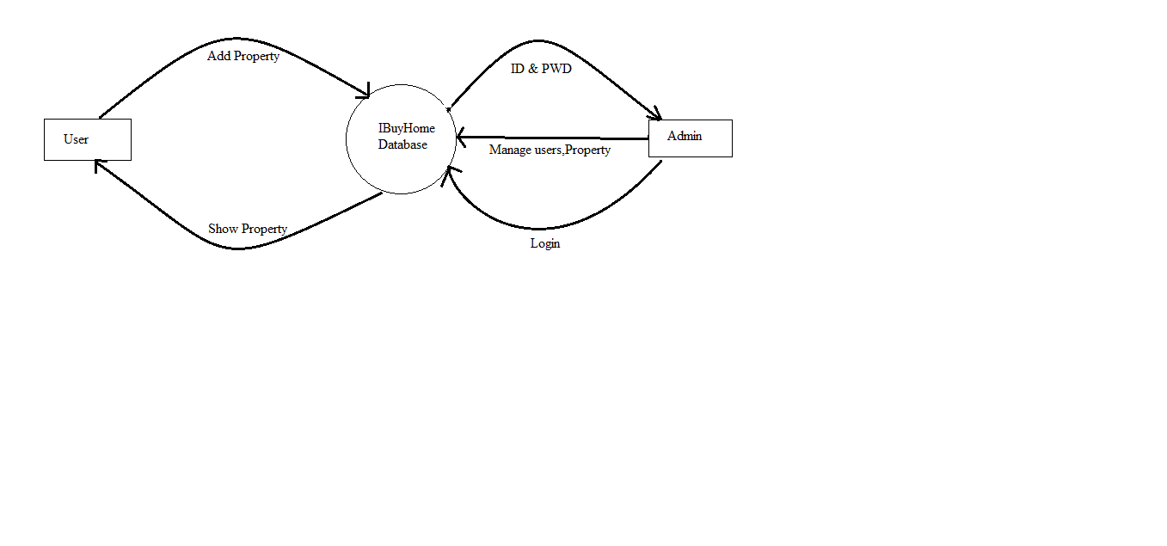
DATA FLOW DIAGRAMS

Slide 16
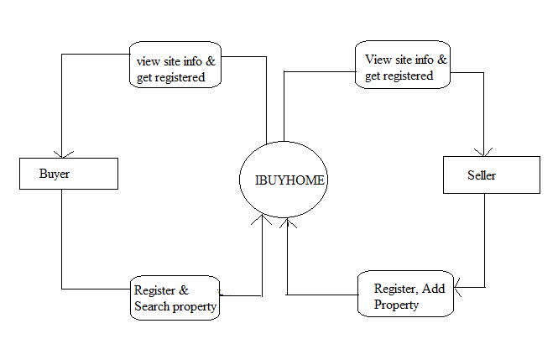

Slide 17
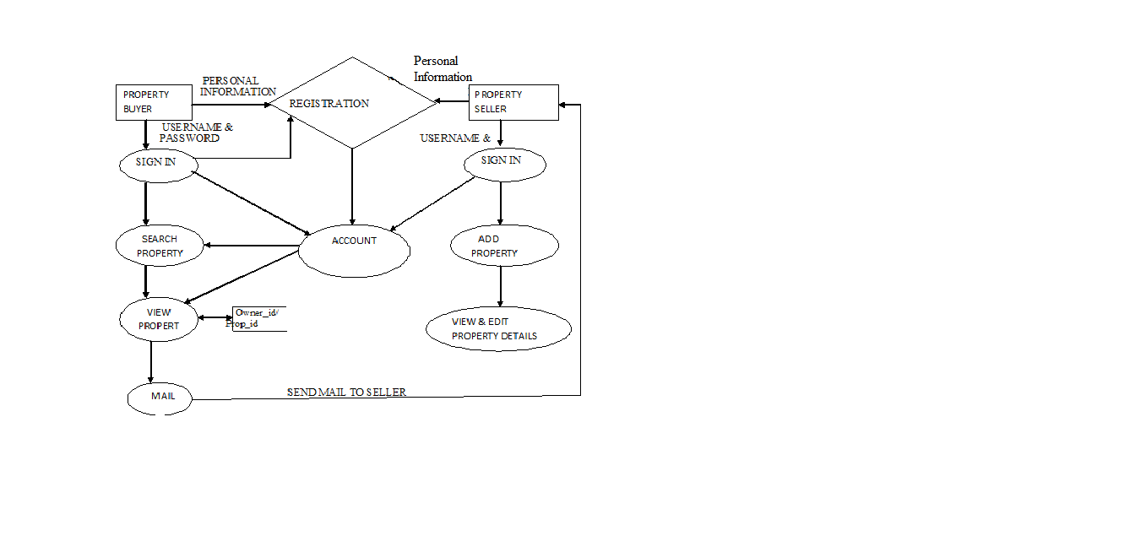

Slide 18
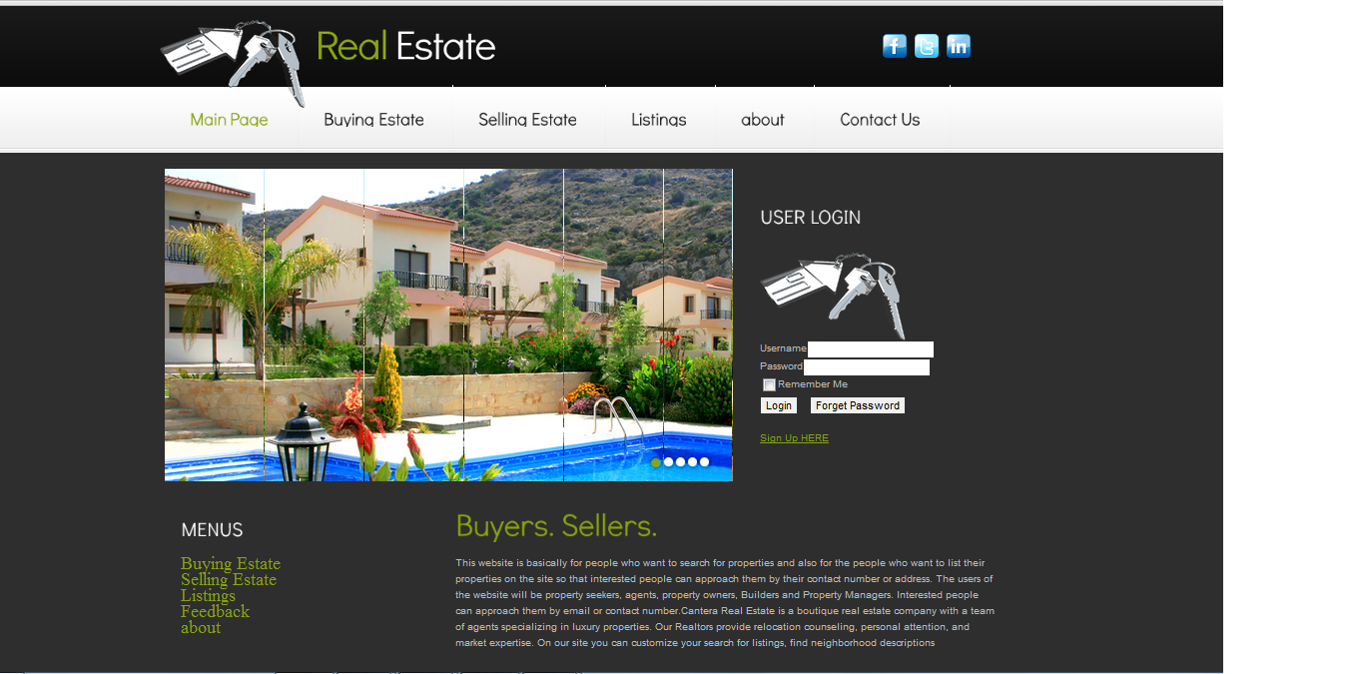
SNAPSHOTS
Home Page

Slide 19
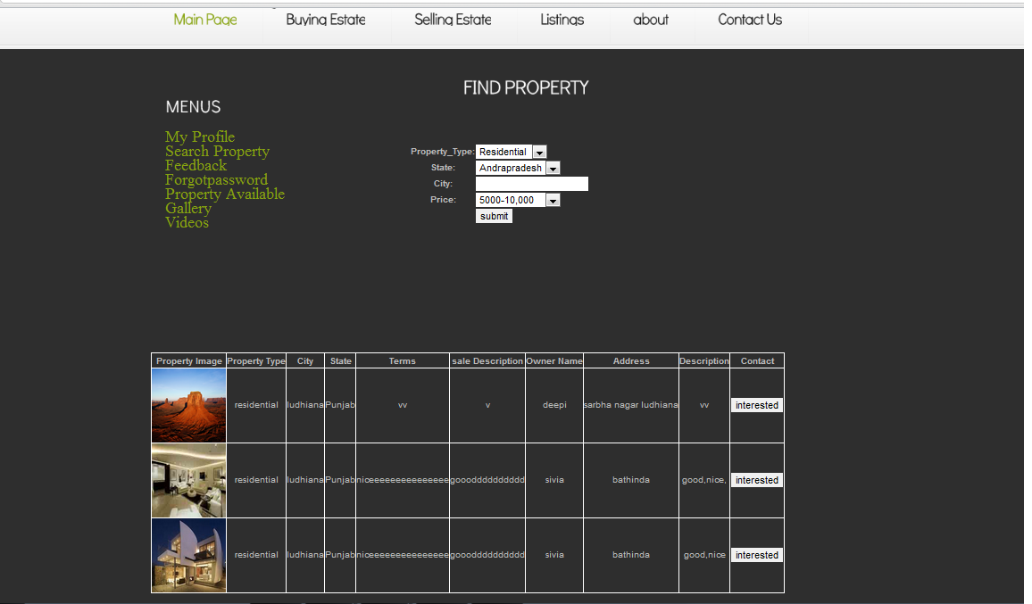
Find Property Page

Slide 20
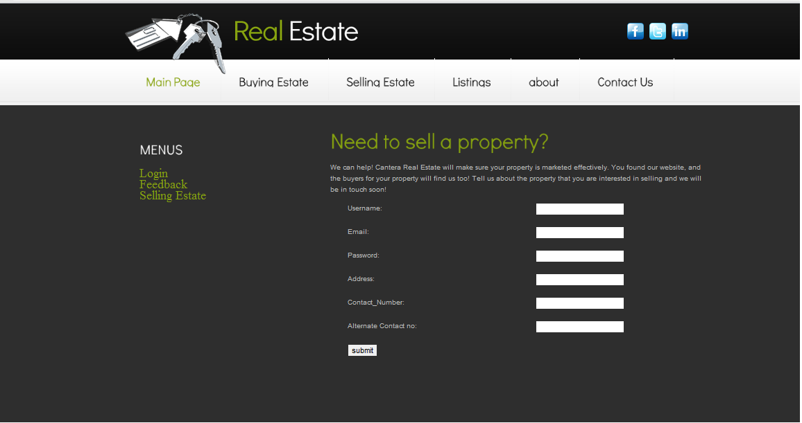
Seller Registration

Slide 21
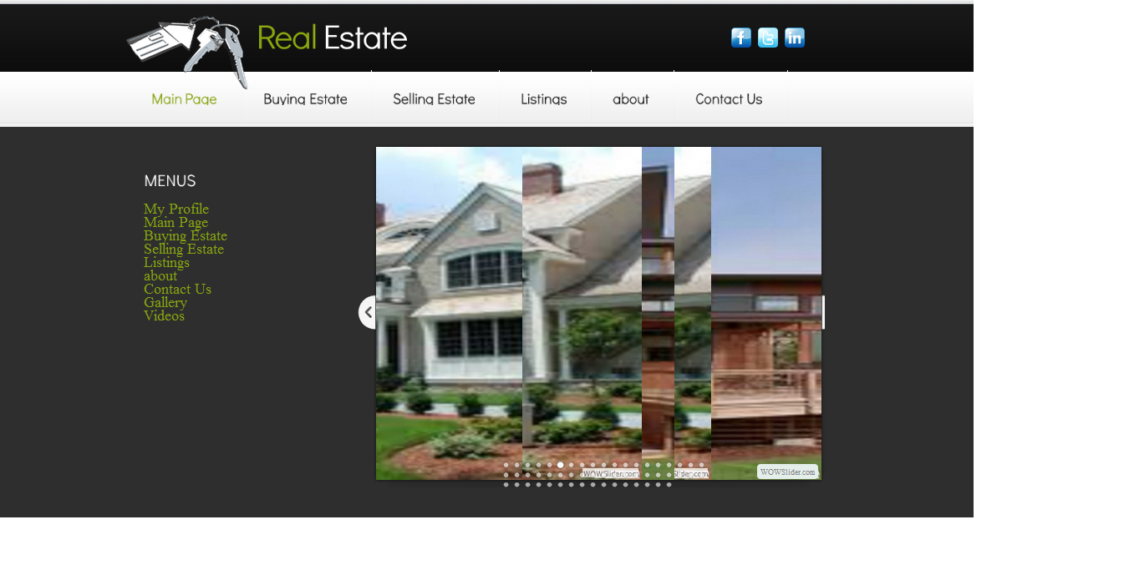
Gallary

Slide 22

Property listing

Slide 23
REFRENCES
Robert Richards, 2006 ―Pro PHP XML and Web Services‖, Library of Congress Cataloguing. P: 163-79 .11 January,2013
Apache Functions‖, PHP Tutorial – Apache Functions, http://phptutorial.info/?apache, 3 Feb 2012.20 , 20 january,2013
Elizabeth Naramore, Jason Gerner, Yann Le Scouarnec, Jeremy Stolz, Michael K. Glass, Beginning PHP5, Apache, and MySQL Web Development‖, Wiley Publications, Inc., 2005. , 25 january,2013
Janet Valade, ―PHP & MySQL FOR DUMMIES‖, 2nd edition, Wiley Publications, Inc., 2004 , 30 january,2013

Slide 24
Marc Delisle, ―Creating your MySQL Database: Practical Design Tips and Techniques‖, Packt Publishing, 2006 1 Feb,2013
Tim Converse and Joyce Park with Clark Morgan, ―PHP5 and MySQL Bible‖, Wiley Publications, Inc., 2004 , 3 Feb, 2013
Lee Babin, Nathan A. Good, Frank M. Kromann, Jon Stephens, ―PHP 5 Recipes A Problem-Solution Approach‖, Apress Publicaitions, 2005 , 10 Feb,2013
―HTML and CSS‖, starting with HTML and CSS, http://www.w3.org/Style/Examples/011/firstcss.en.html, 30 Mar 2013.

Slide 25
THANK YOU

Slide 26
ANY QUERY
?

